Slide 1
How are people dying in Australia, Canada, UK, USA and New Zealand?
By Dhyan Darji

Slide 2


Problem Relevance and Motivation
People are dying around the world and if we find can ‘how’ we might be able to educate the general public about these causes of death.
This will allow for the disease to be prevented to a degree through lifestyle choices or have their early symptoms addressed/scanned. This could potentially save lives which is huge (WHO, 2021) (Cancer Council,2021).
My personal motivation to research this was to find out whether the leading causes of death were preventable or not? Are they in our control or not? And if they were, why are we potentially unable to prevent them?

Slide 3
Method for Analysis
Step 1: Gather data, format it accordingly to visualise and extract information.
Step 2: Graph a histogram of causes of death with their relative count to understand what the leading causes of death are.
Step 3: Compare the effect that the living in a particular country has on how they are likely to die through a world map diagram.
Step 4: Visualise and analyse how the leading factors of death have changed throughout time using a racing bar graph.
Step 5: Make conclusions based on the visualisations above.

Slide 4


Slide 5


World Map

Slide 6
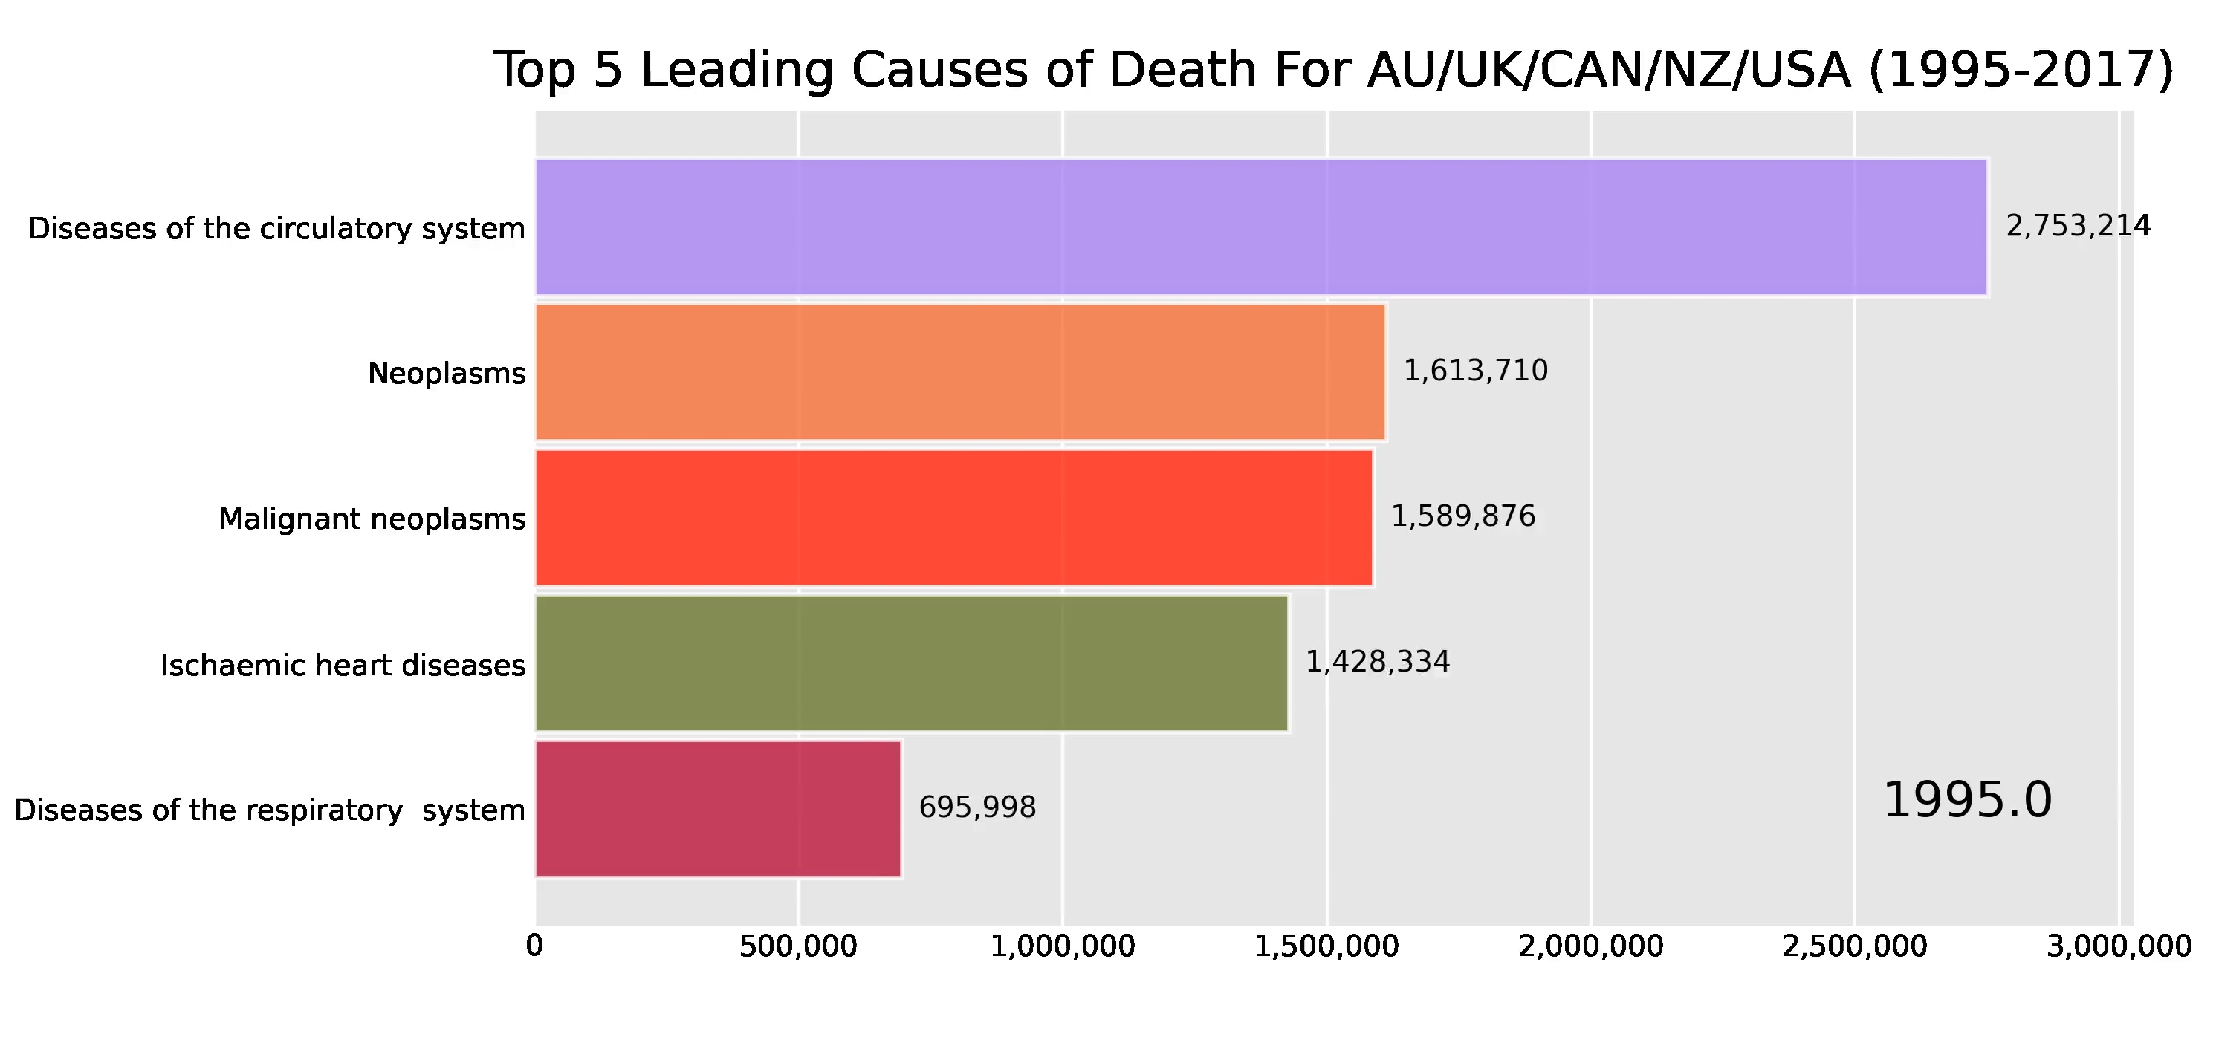
Racing Bar Plot

Slide 7
Thanks!

Slide 8
Resources
Council, C., 2021. Early detection and screening. [Online] Available at: https://www.cancer.org.au/cancer-information/causes-and-prevention/early-detection-and-screening [Accessed 9 September 2021].
WHO, 2021. Promoting Cancer Early Diagnosis. [Online] Available at: https://www.who.int/activities/promoting-cancer-early-diagnosis [Accessed 9 September 2021].

